Slide 1

Your IBM Global Subject Matter Experts Cybersecurity Roles, Processes & Operating System Security

Slide 2

Louis Fuka
IBM Security Learning Services Specialist – Guardium
Louis first joined IBM in 1994 as a lab system administrator. He has over fifteen years experience in developing technical instruction for cloud, security, and enterprise management software.
Louis holds five patents in cloud and security technology. He earned a Bachelor of Science in Electronic Engineering and Bachelor of Arts in Philosophy from the University of Notre Dame du Lac. He earned a Master of Science in Electronic Engineering from the University of Texas at Austin. He served over six years in the United States Marine Corps, including deployment to Desert Shield/Desert Storm.
Joe Speno
Senior Business Process Analyst
IBM Security Services
Joe has been with IBM since 1985 in roles centered around Business Process Management, Quality Management, Continuous Process Improvement, and Process Strategy. He has led process improvement projects, designed process governance programs, and delivered process education. He was an IBM Manager of Process Architects for 15 years.
He holds an undergraduate degree in Marketing from Elmhurst College (Elmhurst, Illinois), and a Masters Degree, with a marketing emphasis, from Lewis University (Romeoville, Illinois)
Joe resides in Nashville Tennessee, with his wife and three children. He enjoys playing and writing music , and restoring vintage cars in his spare time

Slide 3
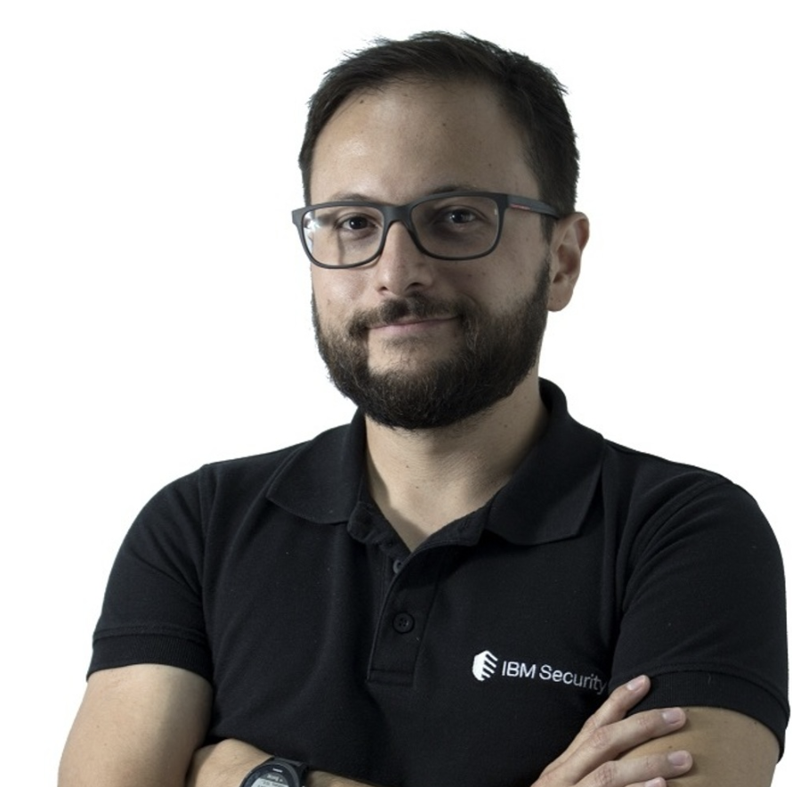
Kenneth Gonzalez Pentester - X-Force Red IBM Security
Kenneth have more than 10 years of experience in the IT Security field. Currently he works as Pentester within X-Force Red the IBM offensive cybersecurity division. Also he hold multiple IT Security certifications such as CPTE, CEH, CISSP, CISA, CISM, PENTEST+ and more.
Javier Bernardo Portuguez Mora
MSS SIEM Security Correlation Engineer
IBM Security
Javier is an experienced Security Engineer with a demonstrated history of working in the information technology and services industry.
He is skilled in technical Support, Systems Engineering, Network Security and Security Information and Event Management (SIEM). Javier is a strong information technology professional with a Bachelor's Degree focused in Systems Engineering and many vendor certifications.

Slide 4

Elio A. Sanabria Echeverria
X-Force Red
Elio is a breaker of things with over 10 years of experience on different technology fields such as offensive/defensive security.
John F. McLaughlin Executive Security Architect,
IBM Federal
John is a highly accomplished senior executive officer and advisor with more than 25 years of success with information technology applied to the hardest of US Federal problems. He is an expert in risk-based approaches to cyber security, critical infrastructure protection, and high-risk program management and has a deep understanding of national security and intelligence strategic and tactical perspectives.
In addition to his professional expertise, John is an adjunct professor at George Mason University instructing in several classes in Senior Design, network security, security frameworks, cryptography, and attack vectors.
John has an MS in Computer Science from University of Southern Mississippi, and a B.S. in Electrical Engineering from George Mason University. He is also a Distinguished Architect with The Open Group and a member of INSA.

Slide 5

Domenico Raguseo
Chief Technology Officer (CTO)
IBM Security-Italy
Domenico is currently CTO for IBM Security in Italy , SPIGI and CEE . He has over 17 years of management and 27 years of experience in cybersecurity. Domenico also cooperates with several Universities by teaching Service Management , Cloud Computing , CyberSecurity . Domenico is former IBM Master Inventor with multiple patents and publications in several disciplines ( Business Processes, ROI, Messages and Collaborations, Networking ... ). Author for the Clusit Report and on securityintelligence.com . Finally he is speaker in several national and international events
Warren Perez Araya
SIEM Administrator-MSS
IBM Security
Warren is a computer engineer who graduated from Universidad Nacional of Costa Rica with experience in Windows and Linux platforms. He has worked as a system and network administrator for over 6 year and was in charge of securing the network and infrastructure of the company, working with multiple network devices and vendors like Cisco, Fortigate, PFSense, MikroTik, etc; as well as infrastructure devices like Windows and Linux servers, IDS/IPS, Domain Controllers, etc. Warren joined IBM in 2015 as a Security Information and Event Management Administrator.

Slide 6
Jude Lancaster,CISSP
Cybersecurity Specialist, North America Security Public Sector and Healthcare
Jude is a technical leader in cybersecurity who specializes in endpoint and mobile security solution. He has over 20 years of IT experience.
Jude currently works as a technical sales specialist working with clients in the Public and Healthcare industries.
Oscar Jose Calderon Gonzalez
Manager, Global MSIEM Administrators
IBM Security
Oscar has over 10 years of experience working in Cybersecurity operations management and consulting. He has certifications in several areas including: CISSP, CISM, ITIL and GSEC,
Oscar is currently a Security Operations Manager based out of Costa Rica.

Slide 7
Coreen Ryskamp Program Manager
IBM Security Learning Services
Coreen is a program manager with IBM Security Learning Services with responsibilities in cybersecurity course development, open badging and academic partnership programs. Coreen has many years of experience collaborating with business partners, startups and academia to create unique programs around technology, industry and skills development. Most recently Coreen has over 30 years experience in Project Management and Information Technology.
Ben is an instruction designer and eSupport specialist for IBM Security Learning Services. His past experience includes developing courseware for IBM Identity Governance and Intelligence and many years managing the Tivoli Professional Certification Program and various enablement development and publishing teams.
Prior to coming to IBM 20 years ago, Ben was a structural engineer specializing in bridge design and the development of structural analysis, bridge and highway design software
Benjamin Briggs
Client Content Strategist
IBM Security

